Slide 1

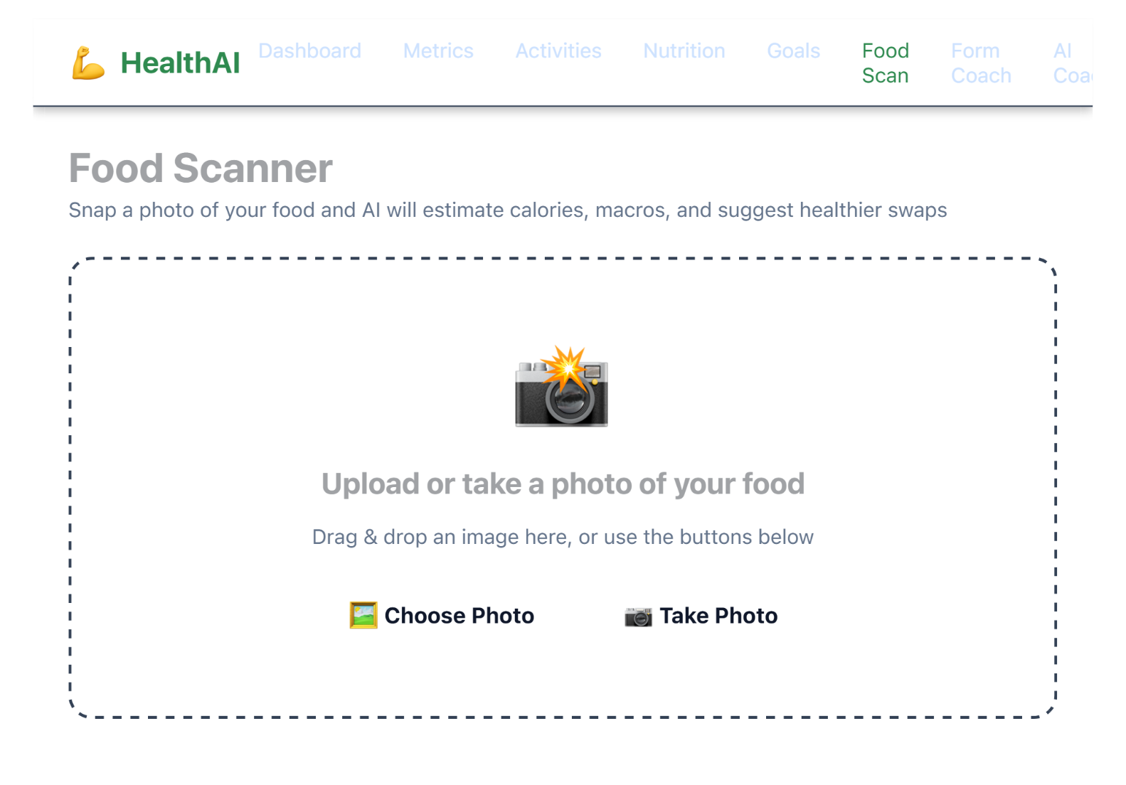
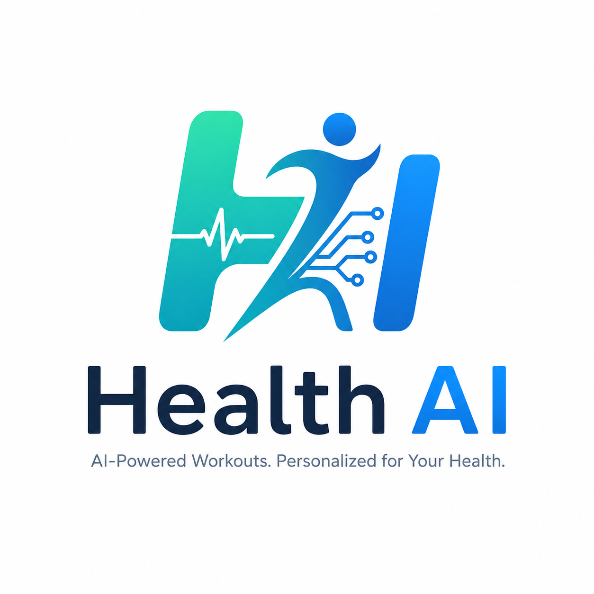
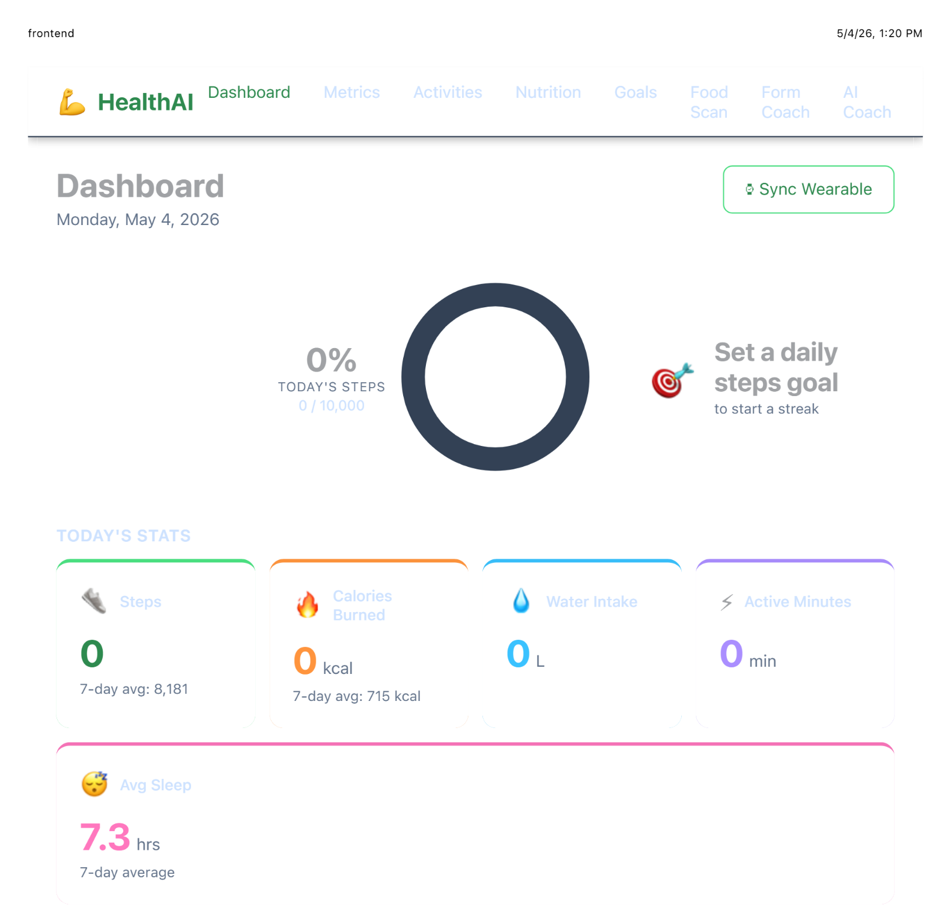
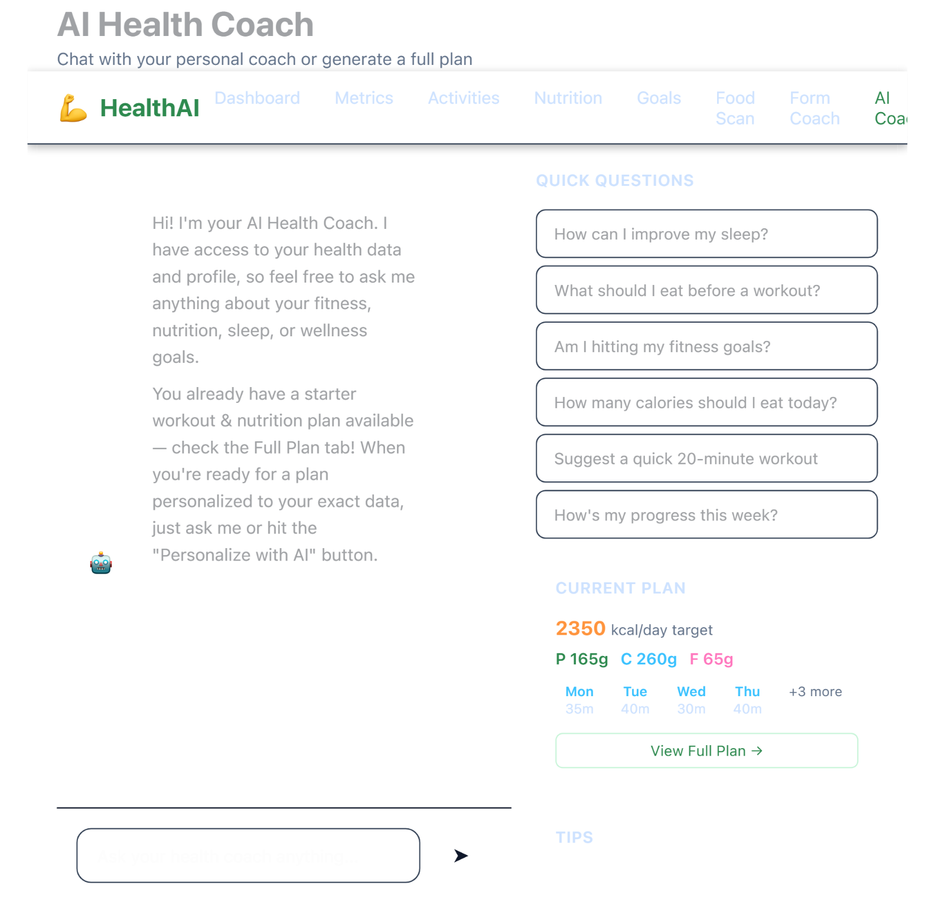
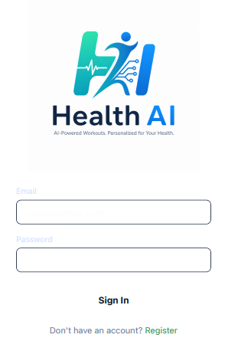
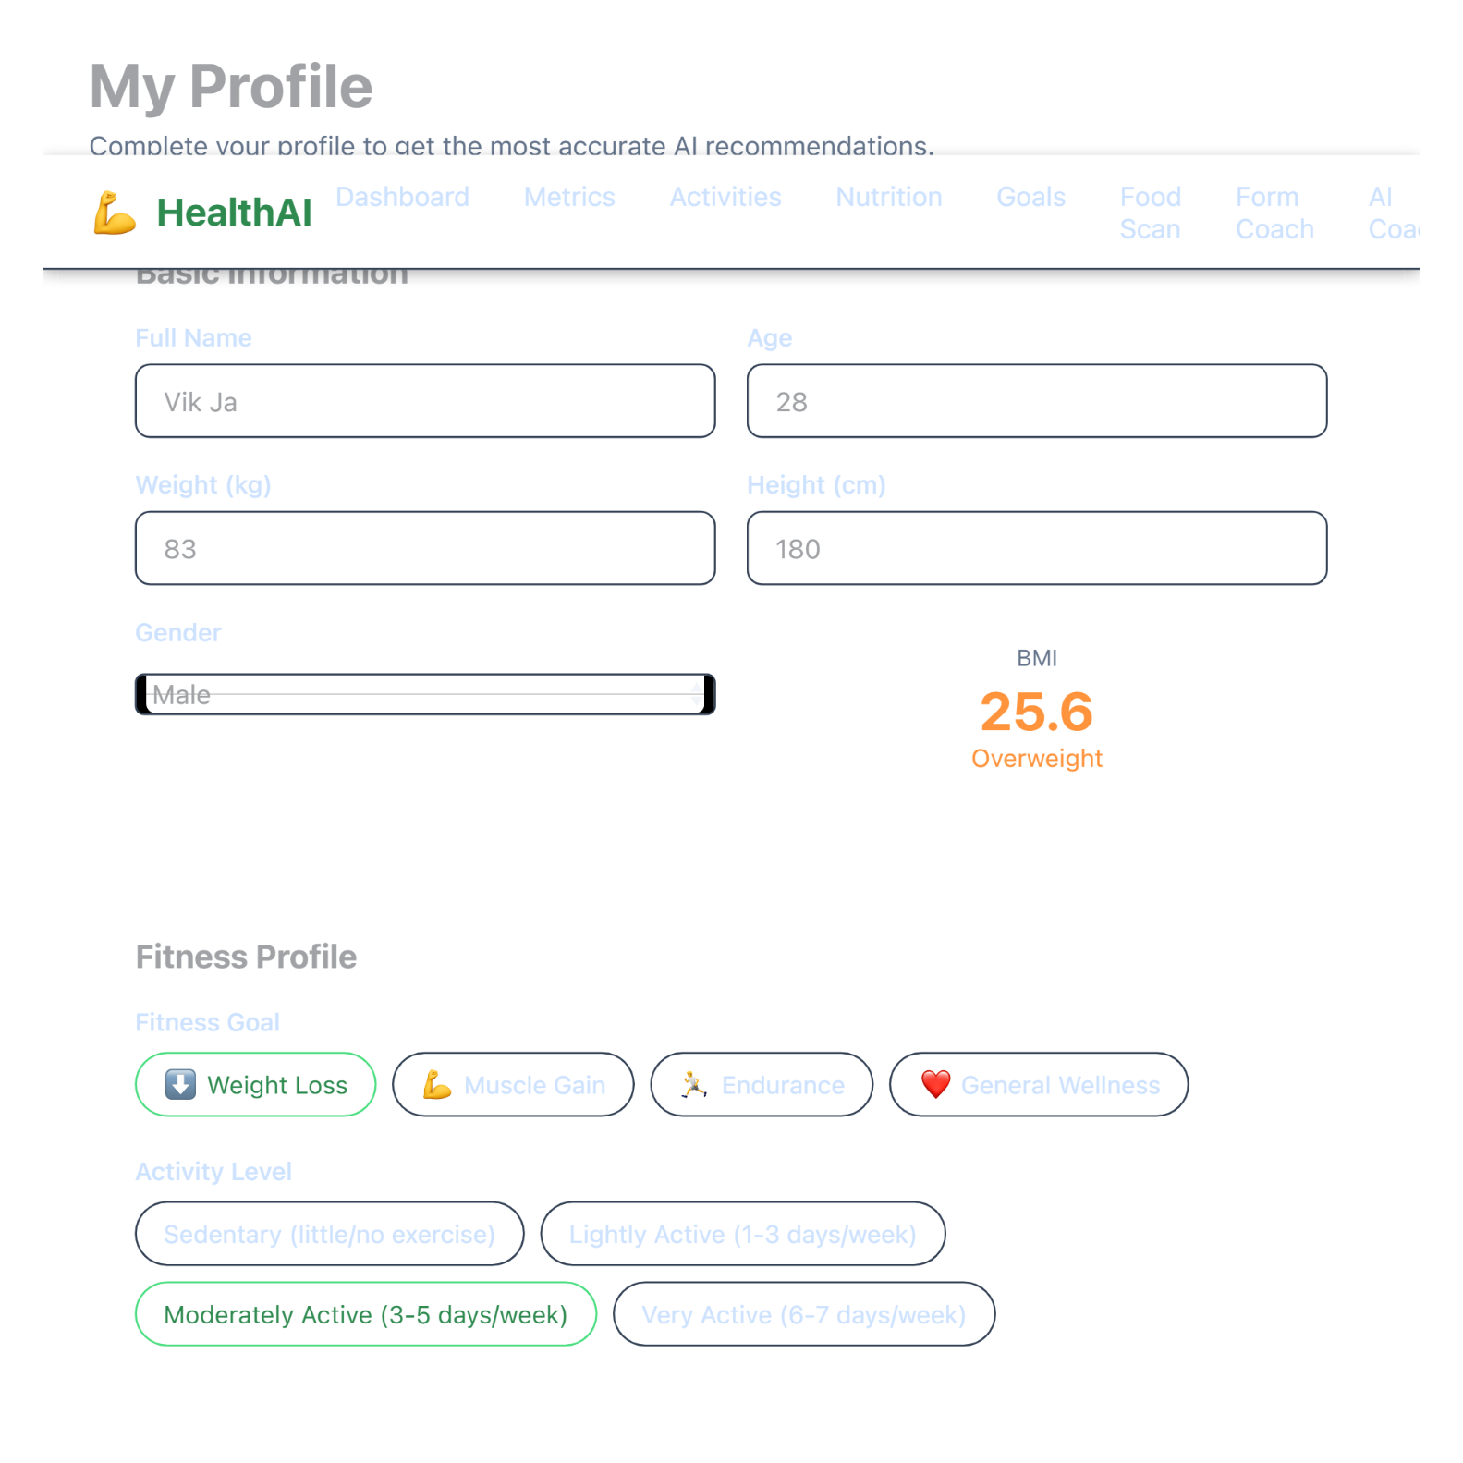
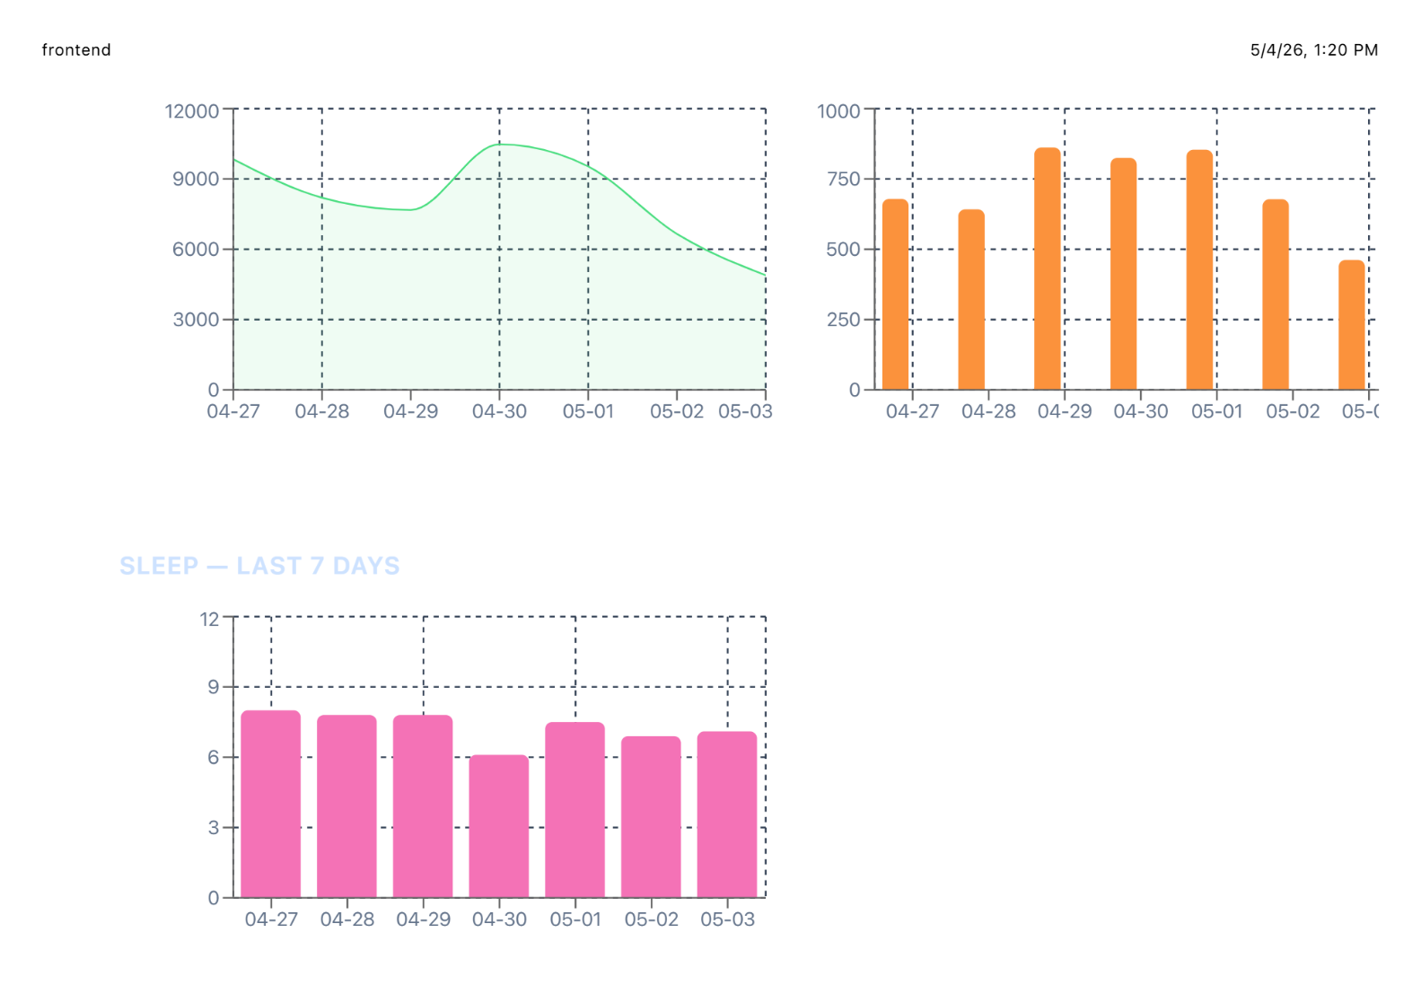
Computer Engineering Department
Health AI
Project Advisor: Vijay Eranti
Jakamukala, Vikranth (MS Software Engineering) Khanchandani, Nikhil (MS Software Engineering)
Nguyen, Dustin (MS Software Engineering)
Patel, Chint (MS Software Engineering)
Introduction
Analysis and Results
HealthAI is an AI-powered web app that helps users understand and manage their health data more effectively. With the rise of wearables, people generate large amounts of data (steps, calories, sleep, heart rate), but most apps present it in ways that are hard to interpret.
The HealthAI system was evaluated based on usability, system responsiveness, and the effectiveness of AI generated outputs. The goal of the evaluation was to determine how well the system transforms raw user data into meaningful and actionable insights.
The AI recommendation system was evaluated using different user profiles with varying fitness goals, activity levels, and dietary preferences. The results show that the AI generates context aware and personalized outputs rather than generic plans. For example, users with different goals such as weight loss or muscle gain received distinct workout structures and nutritional suggestions. This indicates that the system effectively incorporates user specific attributes into the recommendation process.
The conversational AI coach was tested for relevance and usability. It was able to respond to user queries related to fitness, nutrition, and progress tracking using context from stored user data. This improves the overall user experience by allowing users to interact with the system in a natural and flexible way instead of relying solely on static dashboards.
HealthAI Dashboard
Summary/Conclusions
HealthAI solves this by combining health tracking, artificial intelligence, and interactive visuals into one platform. Users can log metrics, track workouts, monitor nutrition, and set personalized goals.
Unlike traditional apps, HealthAI provides personalized, AI-driven recommendations based on individual factors like fitness goals, age, and lifestyle. It also includes a conversational AI coach for real-time guidance.
Goal: Turn raw health data into actionable insights to improve decision-making, boost engagement, and support long-term healthy habits.
HealthAI is an AI-powered health and fitness application that combines data tracking, visualization, and personalized recommendations into one platform.
It helps users understand their health data more clearly and make better decisions to improve their daily habits and overall wellness.
Ozolcer, M., & Bae, W. Sang. (2025). SePA: A Search-enhanced predictive agent for personalized health coaching. arXiv. https://doi.org/10.48550/arXiv.2509.04752
Wang, X., Dang, T., Zhang, X., Kostakos, V., Witbrock, J. M., Jia, H. (2025). HealthSLM-Bench: Benchmarking small language models for mobile and wearable healthcare monitoring. arXiv. https://doi.org/10.48550/arXiv.2509.07260
Violos, J., Diamanti, K., Kompatsiaris, I., Papadopoulos, S. (2025) Frugal Machine Learning for Energy-efficient, and Resource-aware Artificial Intelligence. arXiv. https://doi.org/10.48550/arXiv.2506.01869
Emilio, F. (2024) Large Language Models for Wearable Sensor-Based Human Activity Recognition, Health Monitoring, and Behavioral Modeling: A Survey of Early Trends, Datasets, and Challenges. arXiv. https://doi.org/10.48550/arXiv.2407.07196
From a data perspective, the application successfully captures and organizes multiple types of health information, including daily metrics, activities, nutrition logs, and user defined goals. The dashboard aggregates this data into a centralized view, allowing users to quickly understand their current health status. Visualizations such as trend charts for steps, calories, and sleep provide a clear representation of progress over time, making it easier for users to identify patterns and maintain consistency.
The logging features were tested across different use cases, including manual entry and simulated wearable data. These inputs were consistently stored and retrieved without performance issues, demonstrating the reliability of the backend system and database design. The system also supports real time updates, where newly entered data is immediately reflected in the dashboard and charts.
Key References
Methodology
The system is designed using a full-stack architecture consisting of a frontend, backend, database, and AI service integration. The frontend is built using React and TypeScript, providing a responsive interface for dashboards, logging, and visualization. The backend is implemented using FastAPI, which handles API requests, data processing, and communication with external AI services.
The food scanning feature demonstrates the integration of multimodal AI within the application. When users upload images of meals, the system identifies food items and generates estimated nutritional values, including calories and macronutrients. In addition, the system provides suggestions for healthier alternatives and highlights key nutrients, offering users immediate feedback on their dietary choices.
Overall, the results show that HealthAI successfully integrates data tracking, visualization, and AI driven insights into a single platform. The system provides a cohesive and interactive experience that supports informed decision making and encourages consistent engagement with personal health data.
HealthAI Metrics
HealthAI Login & Profile
Acknowledgements
The authors appreciate and express their gratitude towards Professor Vijay and Dan Harkey for providing assistance in this project.
User data such as metrics, activities, and nutrition logs are stored in a relational SQLite database using SQLModel. The system processes this data to generate summaries and trends.
Artificial intelligence features are powered by the Claude API. The backend constructs prompts using user data and sends them to the AI model to generate personalized workout plans, nutrition advice, and chat responses.

